Slide 1



Artificial Neural Networks
Classification using Single Layer Perceptron Model
Session Starts By 4.00pm
International Baccalaureate (IB)

Slide 2
Classification Example
The following table shows sample data obtained from two
different fruits.
 | Weight (grams) | Length (cm)
Fruit 1 (Class C1) | 121 | 16.8
 | 114 | 15.2
Fruit 2 (Class C2) | 210 | 9.4
 | 195 | 8.1
Train a single layer perceptron model using the above parameters to classify the two fruits.
Using the model parameters you have obtained classify the fruit
with weight 140gm and length 17.9cm.

Slide 3
Classification Example
 | Weight (grams) | Length (cm)
Fruit 1 (Class C1) | 121 | 16.8
 | 114 | 15.2
Fruit 2 (Class C2) | 210 | 9.4
 | 195 | 8.1
X₂(Length in cm)
Class C
1
20
16
12
8
4
(121,16.8)
(114,15.2)
(210,9.4)
(195,8.1)
Class C₂
50 100 150 200 250
X₁(Weight in grams)

Slide 4
Solution to the Example Question
(with correct initial weights and bias)

Slide 5
Solution to the Example
(with correct initial weights and bias)
w (0) = −
30, w (0) = 300,
ü
With correct initial weights and bias
1 2
ý
given
b(0) = 50, η = 0.01
þ
Fixed Input
50
Activation Function
x = +1
0
x₁
-30
sig(.)
å
Output
y(n)
x₂
300
if x ≥ 0
if x < 0
sgn( x) = ^{⎧+1,}
í-1,
î

Slide 6
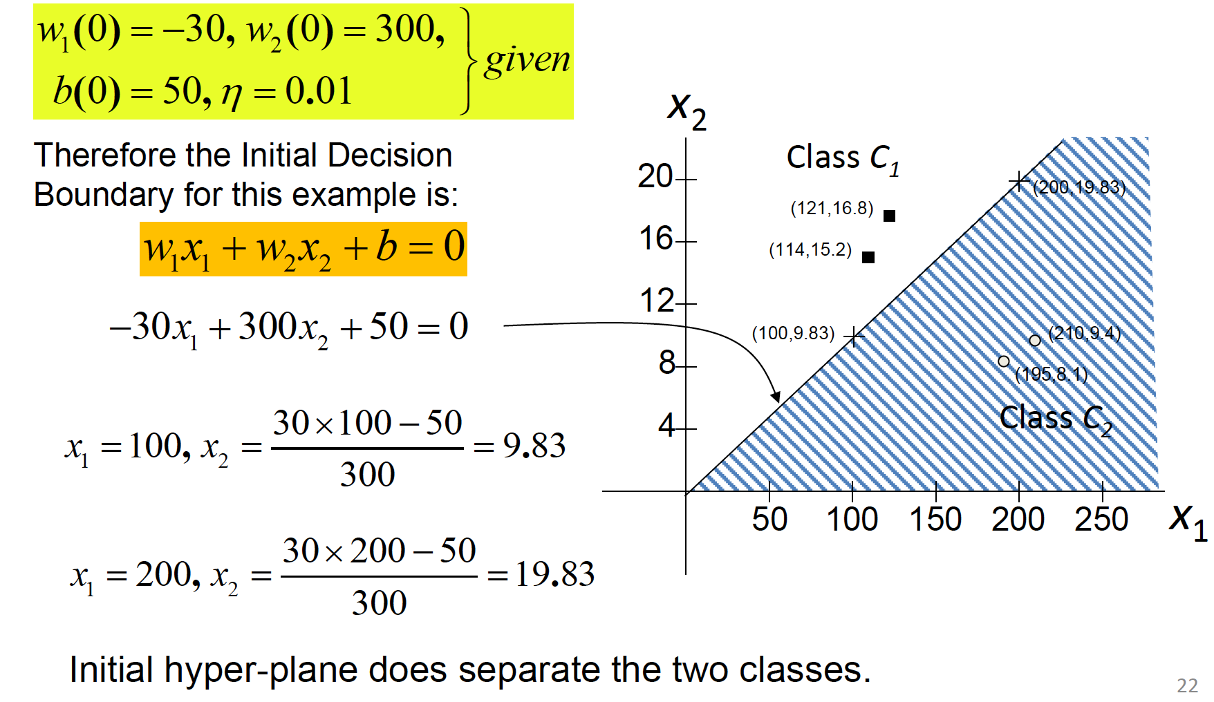
Solution to the Example
(with correct initial weights and bias)

Slide 7
Classification of the Unknown Fruit
Fixed Input
Activation Function
x = +1
50
0
x₁ = 140
-30
sig(.)
+1220
Output
å
x₂ = 17.9
Class Unknown
y_{(n)}=+1
300
Now use the above model to classify the unknown fruit.
x(unknown) = [+1, 140, 17.9]^{T}
For Class C1, Output = +1
w(3) = [50, − 30, 300]^{T}
y(unknown) = sgn(w^{T} (3) x(unknown)) = sgn(50 ×1 − 30 ×140 + 300 ×17.9)
= sgn(1220) = +1
\ this unknown fruit belongs to the class C₁.
23
this unkown fruit belonge to the class

Slide 8
Solution to the Example Question
(with unknown initial weights and bias)

Slide 9
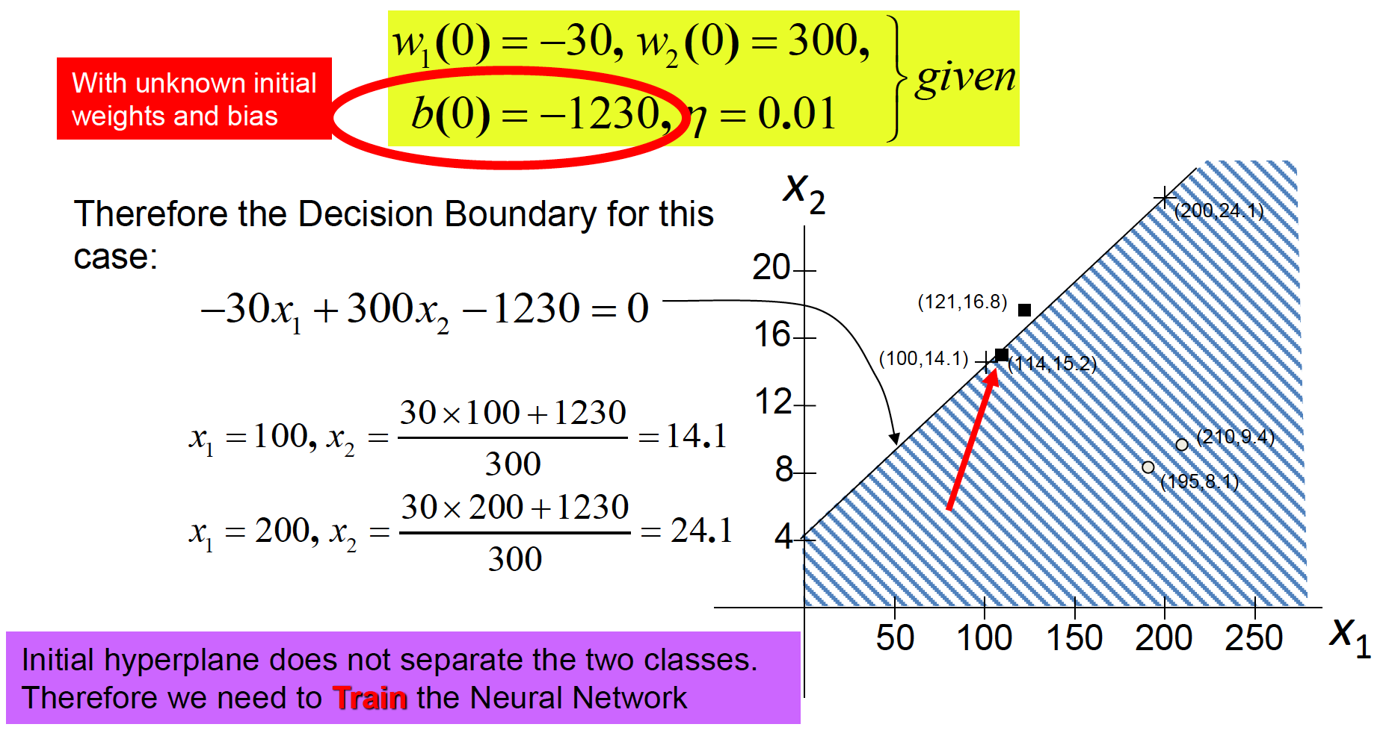
Solution to the Example
(with unknown initial weights and bias)

Slide 10
Training with known Fruit (121,16.8)
Fixed Input
-1230
Activation Function
x = +1
0
x₁ = 121
-30
sig(.)
Output
å
+180
y_{(n)}=+1
x₂ = 16.8
Class C1
300
x(n) = x(0) = [+1, 121, 16.8] ^{T}
and d (0) = +1
For Class C1, Output = +1
w(n) = w(0) = [−1230, − 30, 300]. ^{T}
y(n) = y(0) = sgn(w^{T} (0) x(0))
= sgn(-1230 ´1 - 30 ´121 + 300 ´16.8)
= sgn(180) = +1 = d (0)
Hence no need to recalculate the weights.
\ w(n + 1) = w(1) = [-1230, - 30, 300]. ^{T}

Slide 11
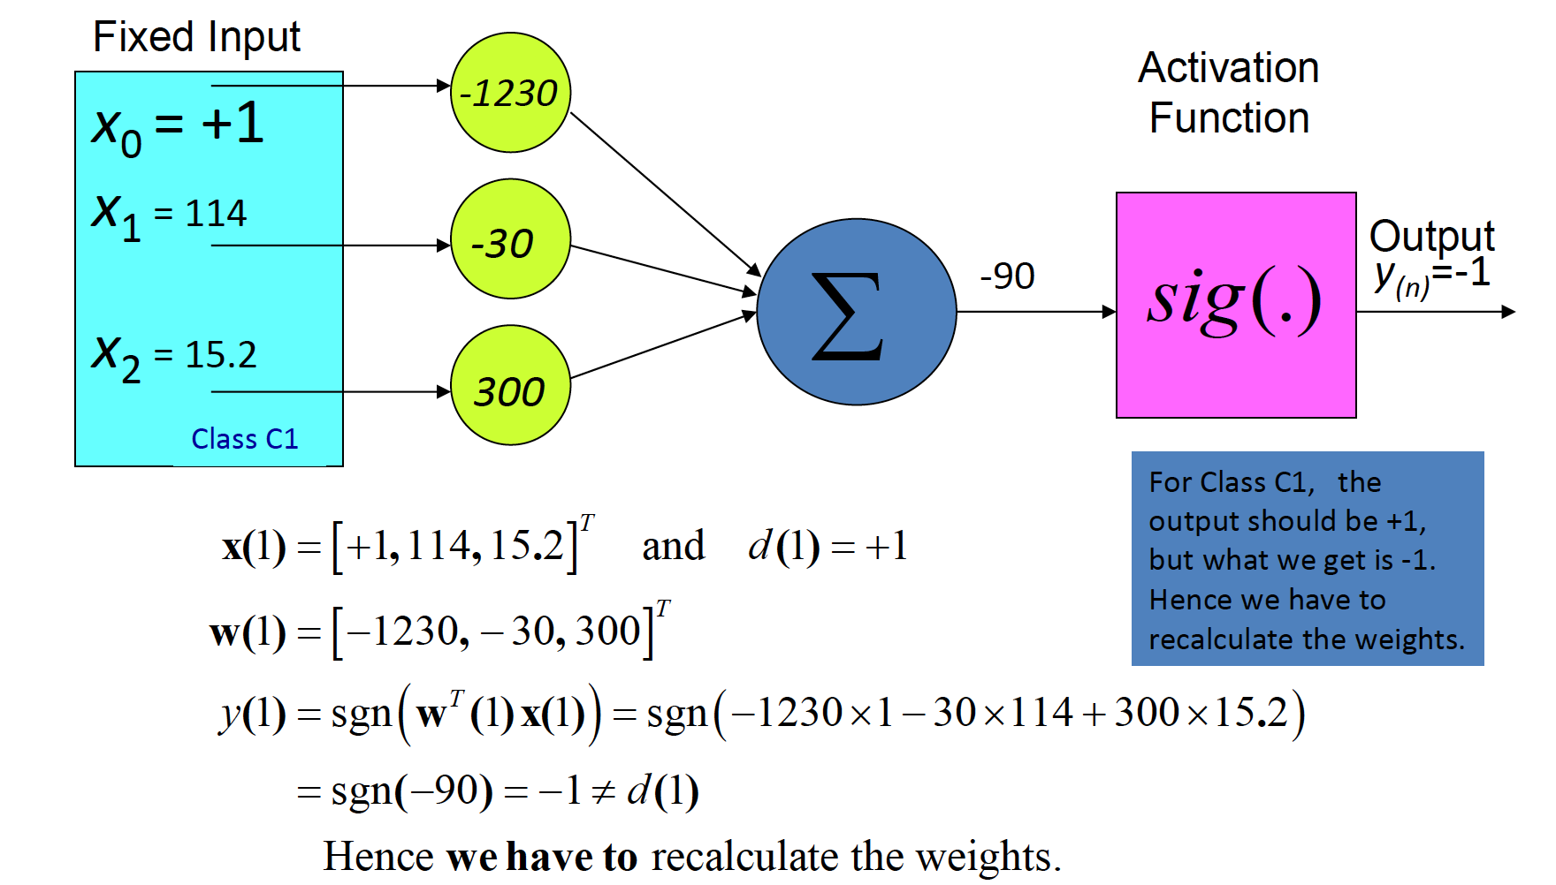
Training with known Fruit (114,15.2)

Slide 12
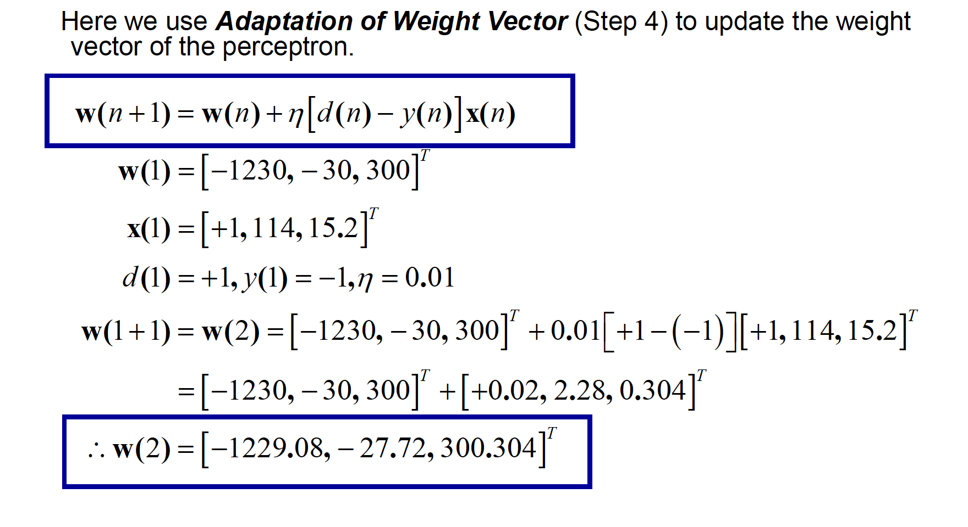
Adaptation of Weight Vector

Slide 13
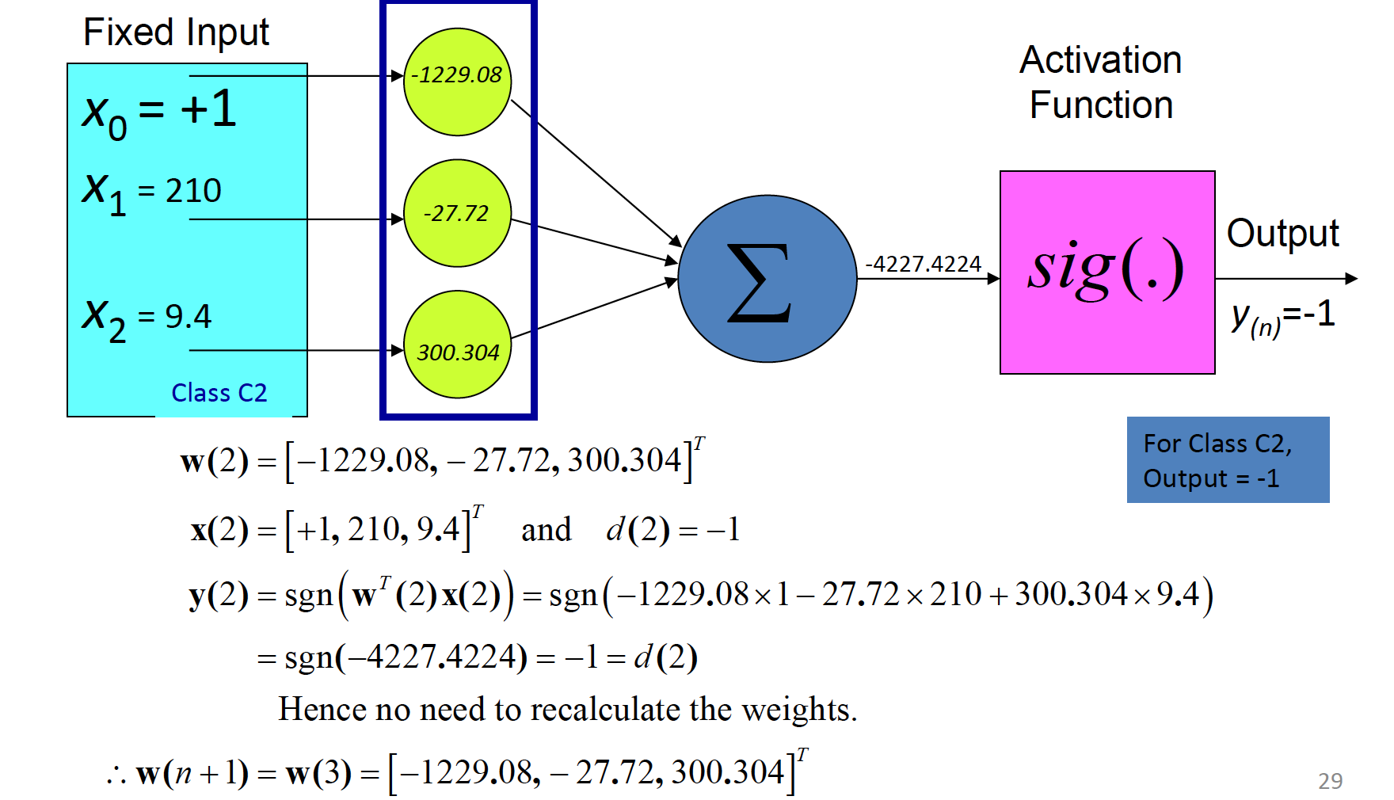
Training with known Fruit (210,9.4)

Slide 14
Training with known Fruit (195,8.1)
Fixed Input
-1229.08
Activation
Function
x₀ = +1
x₁ = 195
sig(.)
-27.72
Output
å
-4202.0176
x₂ = 8.1
Class C2
y_{(n)}=-1
300.304
w(3) = [−1229.08, − 27.72, 300.304] ^{T}
For Class C2, Output = -1
x(3) = [+1, 195, 8.1] ^{T}
and d (3) = −1
y(3) = sgn(w^{T} (3) x(3)) = sgn(−1229.08 ×1 − 27.72 ×195 + 300.304 × 8.1)
= sgn(-4202.0176) = -1 = d (3)
Hence no need to recalculate the weights.
\ w(n + 1) = w(4) = [-1229.08, - 27.72, 300.304] ^{T}

Slide 15
Training with known Fruit (121,16.8)
Fixed Input
-1229.08
Activation Function
x₀ = +1
x₁ = 121
sig(.)
-27.72
Output
å
461.91
x₂ = 16.8
Class C1
y_{(n)}=+1
300.304
w(4) = [−1229.08, − 27.72, 300.304]^{T}
For Class C1, Output = +1
x(4) = [+1, 121, 16.8]^{T}
and d (4) = +1
y(4) = sgn(w^{T} (4) x(4)) = sgn(−1229.08 ×1 − 27.72 ×121 + 300.304 ×16.8)
= sgn(461.91) = +1 = d (4)
Hence no need to recalculate the weights.
\ w(n + 1) = w(5) = [-1229.08, - 27.72, 300.304]^{T}
31

Slide 16
Training with known Fruit (114,15.2)
Fixed Input
Activation Function
x₀ = +1
x₁ = 114
-1229.08
sig(.)
-27.72
Output
å
175.46
x₂ = 15.2
Class C1
y_{(n)}=+1
300.304
w(5) = [−1229.08, − 27.72, 300.304]^{T}
For Class C1, Output = +1
x(5) = [+1, 114, 15.2]^{T}
and d (5) = +1
y(5) = sgn(w^{T} (5) x(5)) = sgn(−1229.08 ×1 − 27.72 ×114 + 300.304 ×15.2)
= sgn(175.46) = +1 = d (5)
Hence no need to recalculate the weights.
\ w(n + 1) = w(6) = [-1229.08, - 27.72, 300.304]^{T}

Slide 17
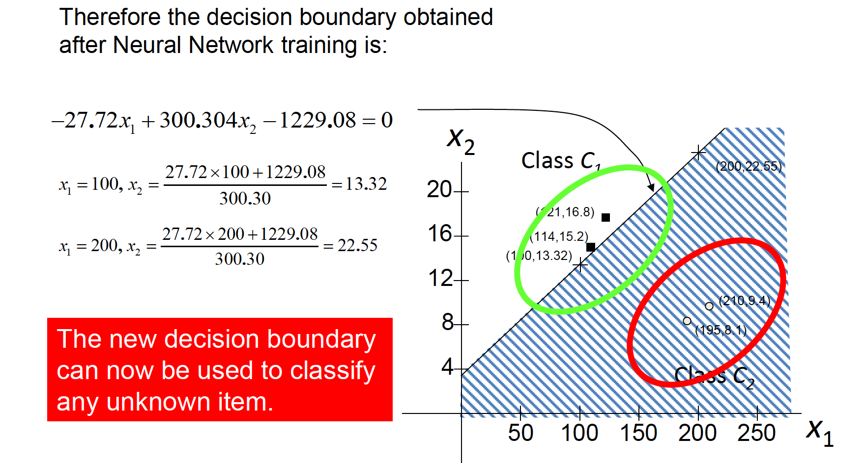
Decision Boundary After Training

Slide 18

Classification of the Unknown Fruit using the New Decision Boundary
34

Slide 19
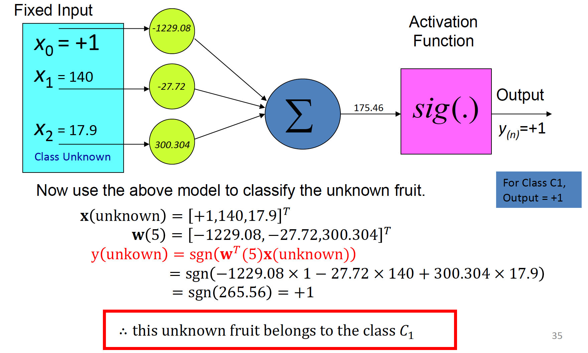
Classification of the Unknown Fruit using the New Decision Boundary
35

Slide 20
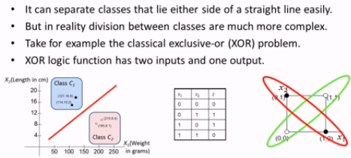
Limitations of Perceptron
35

Slide 21
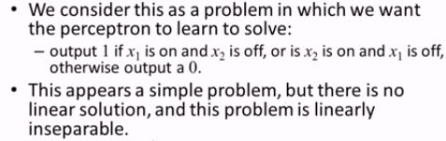
XOR Problem
35

Slide 22
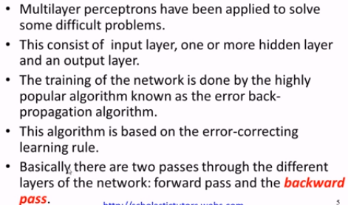
Multi Layer Perceptron

Slide 23
XOR Problem- two layers

Slide 24
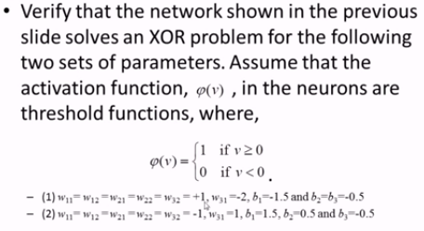
XOR Problem- two layers

Slide 25
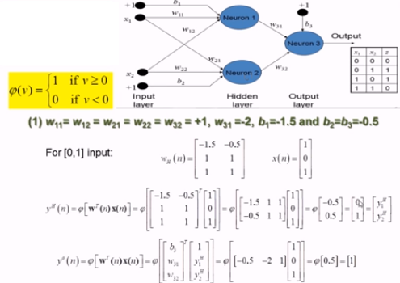

Slide 26
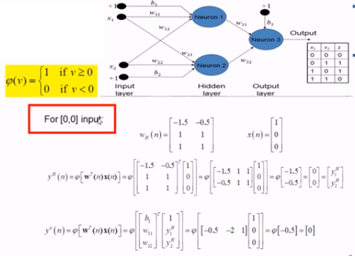

Slide 27
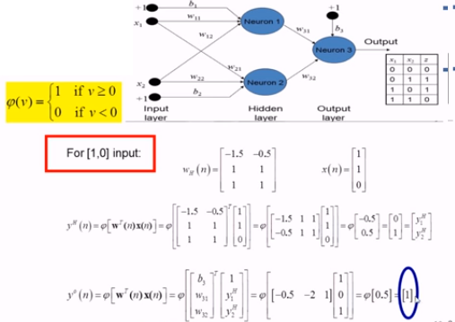

Slide 28
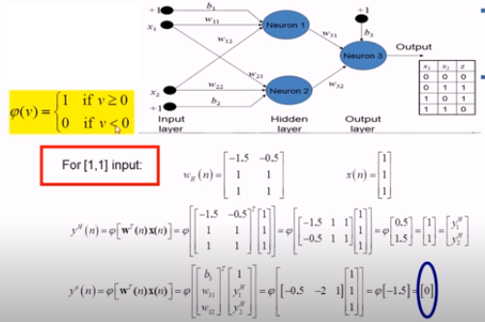

Slide 29
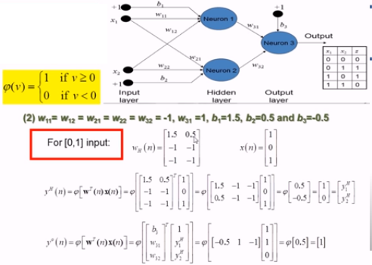

Slide 30
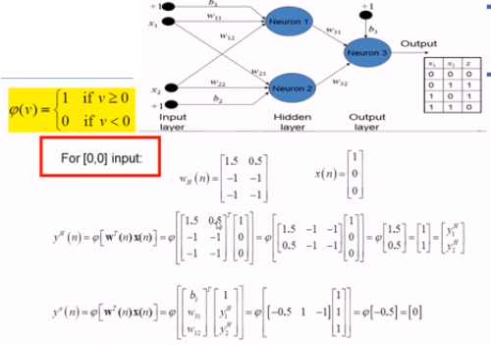

Slide 31
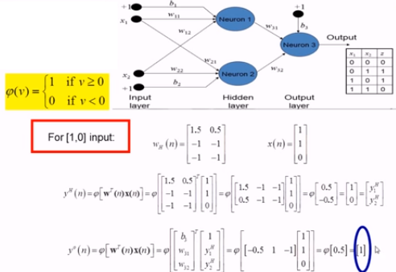

Slide 32
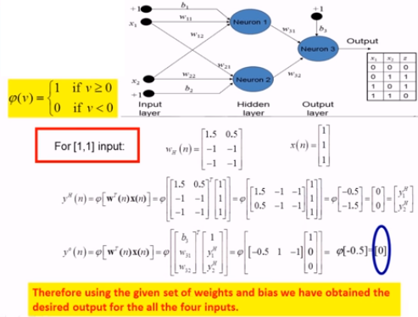

Slide 33
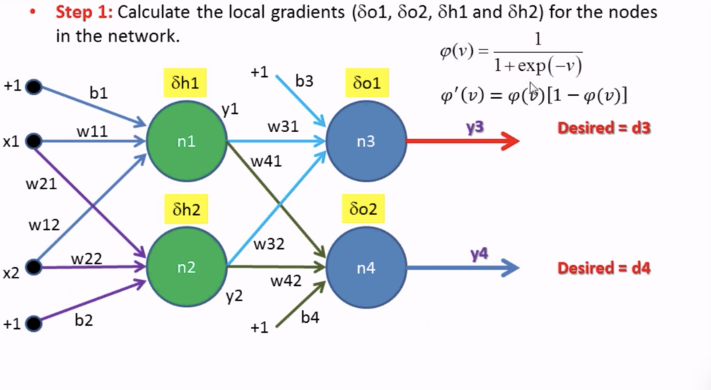
Back-Propagation Algorithm

Slide 34
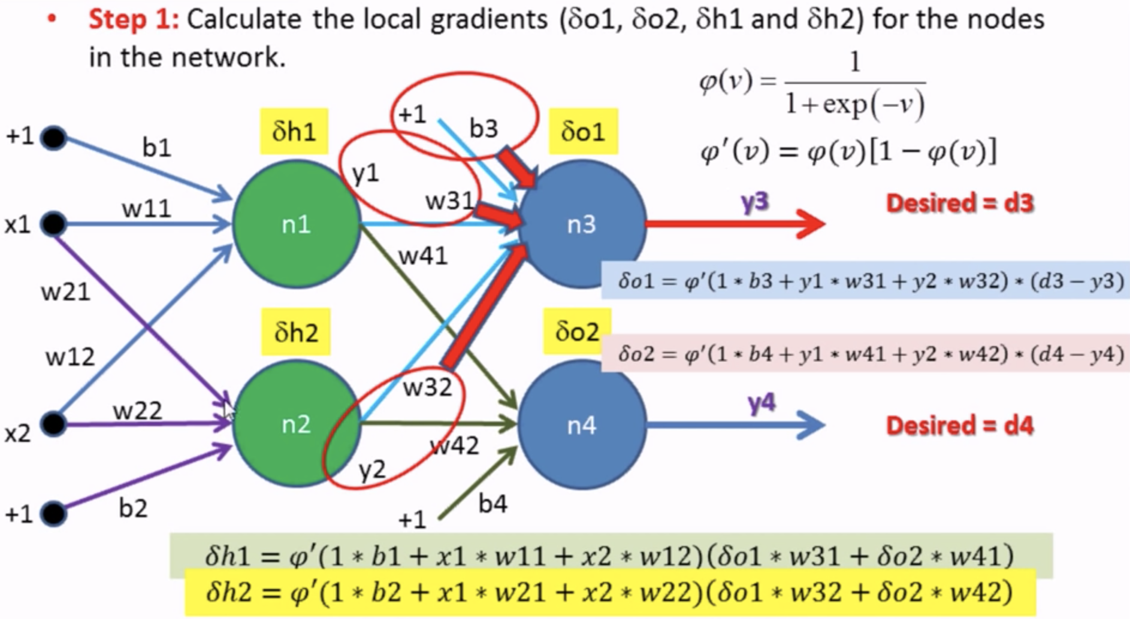
Back-Propagation Algorithm

Slide 35
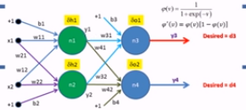
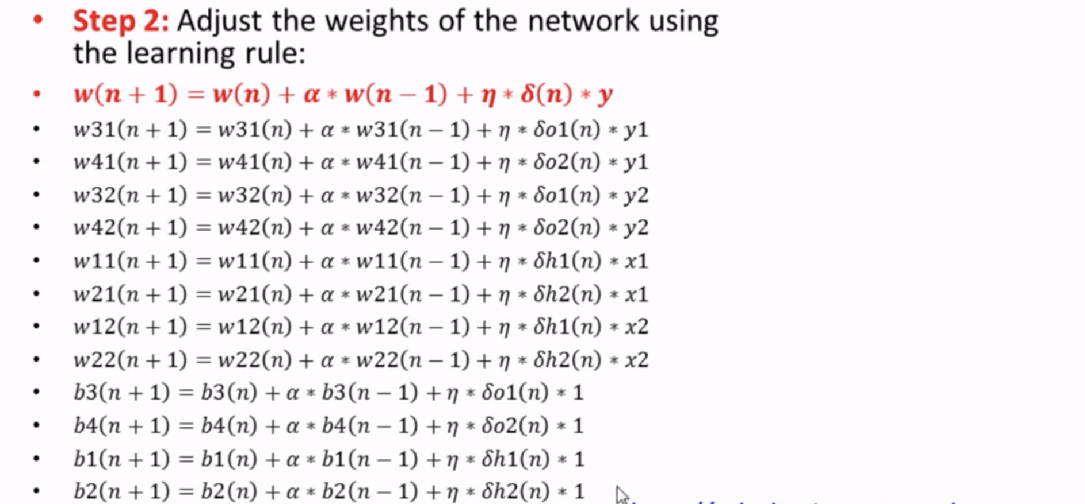
Back-Propagation Algorithm

Slide 36
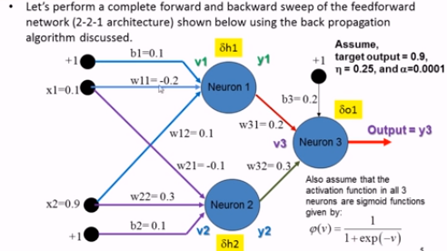
Back-Propagation Example

Slide 37
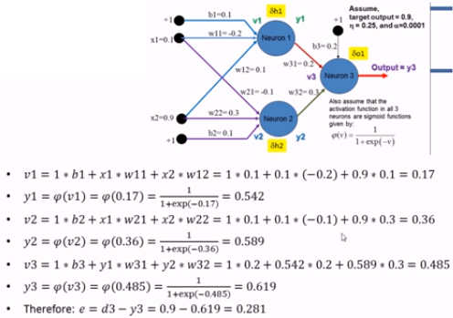
Back-Propagation Example

Slide 38
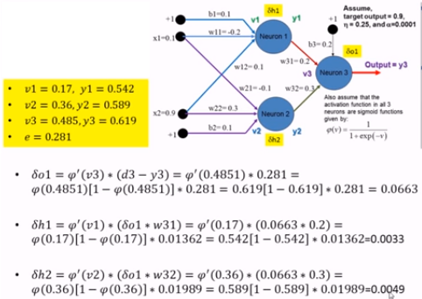
Back-Propagation Example

Slide 39
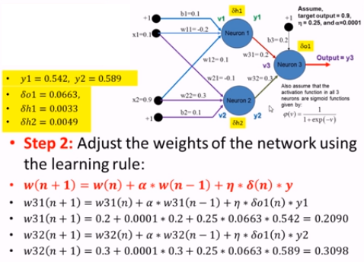
Back-Propagation Example

Slide 40
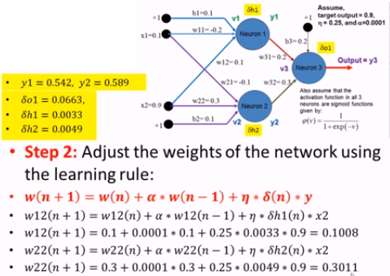
Back-Propagation Example

Slide 41
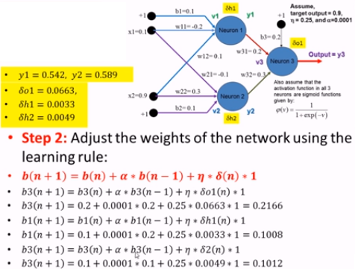
Back-Propagation Example

Slide 42
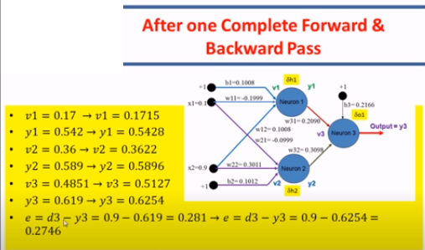

Slide 44
